Slide 1
NORMAL PARTURITION

Slide 2
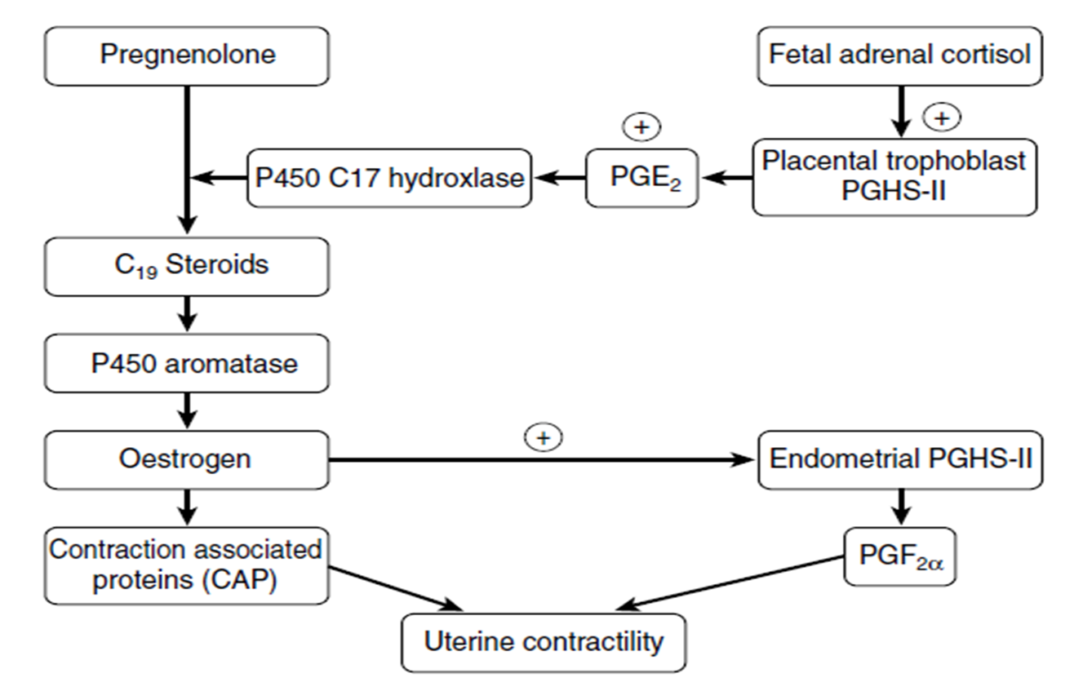
PARTURITION

Slide 3
PARTURITION
The stages of parturition
The first stage of parturition (dilatation of the cervix) characterize with:
1- uterine contraction
At first stage each contraction wave take 15-30 sec for every 10-15 min (longitudinal and circular contraction)
Near parturition the contraction wave increase in frequency and in strength
Before 1 hour from parturition the contraction wave take 2-3 minute for every 2-3 minute (2 minute rest and 2 minute contraction)
Uterine contraction play about 70-90% from the effort of parturition while 10-30% related with abdominal contraction

Slide 4
PARTURITION
The first stage of parturition (dilatation of the cervix)
2- cervix dilatation
The estrogen as well as the relaxin play a role to change the cervix from compact tissue to soft tissue and after that the contraction as well as these two factor lead to cervix dilatation
The dilatation appear from external side of the cervix to the internal part of the cervix
Finally the uterus and the cervix and the vulva become one canal which is called birth canal

Slide 5
PARTURITION
The first stage of parturition (dilatation of the cervix)
3- Weakness in the connection between the placenta and uterus
Mainly because the uterine contraction lead to a necrosis (fatty necrosis) between the caruncle and cotyledon
4- The fetus take the position of parturition (presentation, position, posture) (P.P.P)
Presentation: the relationship between the longitudinal axis of the fetus and the maternal birth canal
Longitudinal (anterior or posterior)
Vertical (dorsal or ventral)
Transverse (dorsal or ventral)

Slide 6
PARTURITION
The first stage of parturition (dilatation of the cervix)
Position: indicates the surface of the maternal birth canal to which the fetal vertebral column is applied
Dorsal
Ventral
Lateral
Posture: refers to the disposition of the movable appendages of the fetus
Flexion
Extension
Retention

Slide 7
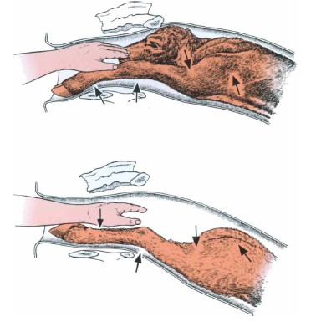
PARTURITION

Slide 8
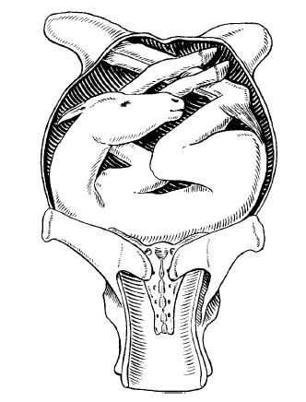
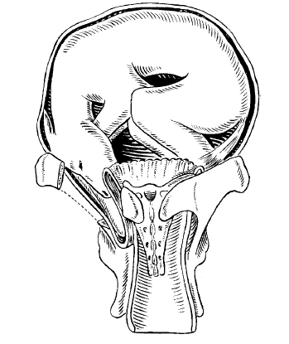
PARTURITION

Slide 9
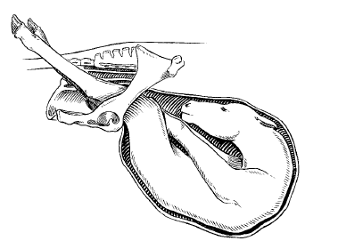
PARTURITION

Slide 10
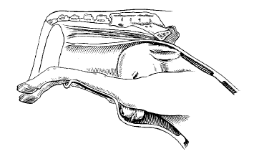
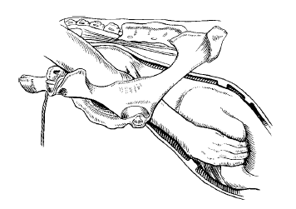
PARTURITION

Slide 11
PARTURITION
The stage of parturition
The first stage of parturition (dilatation of the cervix)
This stage take 6-12 hour according to the species of animals
Many systemic symptoms appear on the animals
Subnormal temperature
Udder enlargement

Slide 12
PARTURITION
The second stage of parturition (expulsion of fetus )
Utero-abdominal contraction (contraction wave continue 1-2 minute in each 1-2 minute)
The fetus enter the birth canal with the amnion
Amnion fluid lubricate the birth canal to facilitate the movement of fetus in birth canal
The fetus inside the birth canal stimulate the posterior lobe of the pituitary gland to secret oxytocin which increase the uterine contraction
Fetus expulsion (with or without the amnion)
The umbilical cord spontaneously cut off or may be take time after parturition

Slide 13
PARTURITION
The second stage of parturition (expulsion of fetus )
This stage take :
15 minute in mare
1 hour in cow and ewe and goat
6 hours in bitch and queen

Slide 14
PARTURITION
The third stage of parturition (expulsion placenta)
It is clear in animals which pregnant with one fetus
In animals which pregnant with many fetus the second and third stage appear together (after parturition the animals expelled the placenta before the second parturition)
After parturition the contraction waves stop temporarily and after a time these waves return to expelled the placenta

Slide 15
PARTURITION
The third stage of parturition (expulsion placenta)
After parturition the caruncles suffer from dilatation and relaxation while the cotyledon suffer from shrinkage (because the blood stopping)
And with uterine contraction the placenta expelled outside the uterus
The estrogen as well as oxytocin play role for expulsion the placenta

Slide 16
PARTURITION
The third stage of parturition (expulsion placenta)
This stage take :
1 hour in mare
6 hour in cow and ewe and goat

Slide 17
Dystocia
The main reasons which lead to dystocia
1- The dam play a role for dystocia
2- The fetus play a role for dystocia

Slide 19
Dystocia
Treatment of dystocia
Obstetrical mutation
Fetotomy
Caesarian section

